Slide 1

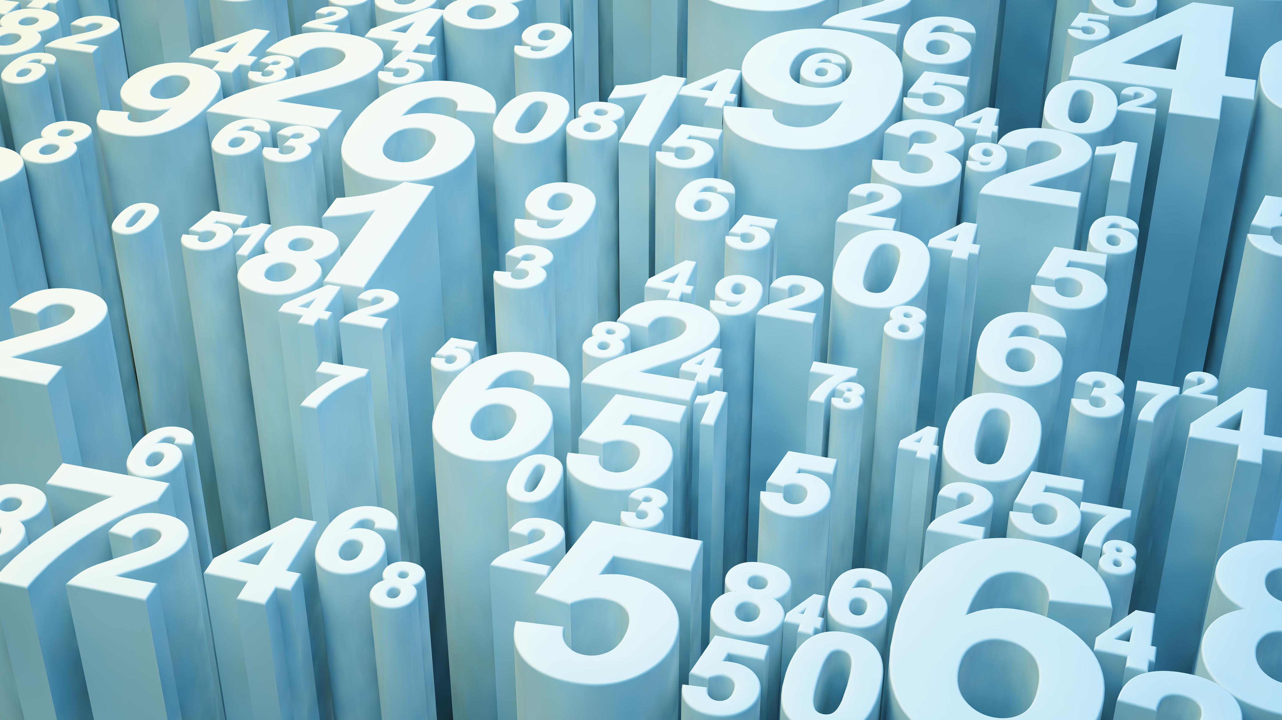
K Nearest Neighbors on Breast Cancer Data
Chayton Hamric
Scott Grisso
Alex Karwowski

Slide 2
Background
Malignant
Generally Larger
Data from Wisconsin Breast Cancer
Benign
Smaller Tumor Size
Has more concavity
212 Malignant
Less Compact
Less Concave Points
Has more Symmetry
569 Total Samples
357 Benign
30 Unique Features to help classify

Slide 3
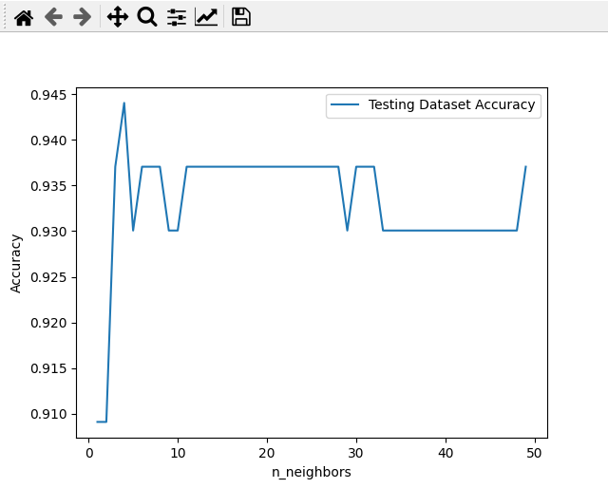
Statistical Summary
Features and Attributes
30 Features in 3 subsets of 10
Scores
Min: 90.9% at 1 NN
Mean, Error and Worst Subsets
Radius, texture, perimeter, area, smoothness, symmetry, fractal dimension
Median: 93.7% Between 15-28 NN
Mode: 93.7%
Max: 94.4% at 5 NN
Mean: 93.3%
STD: 0.006

Slide 4
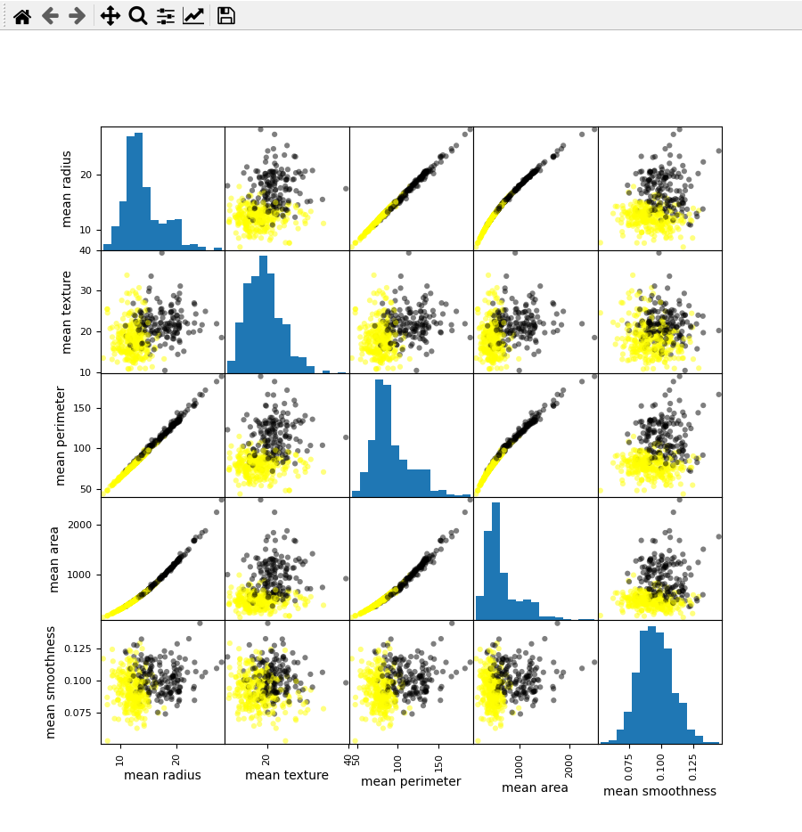
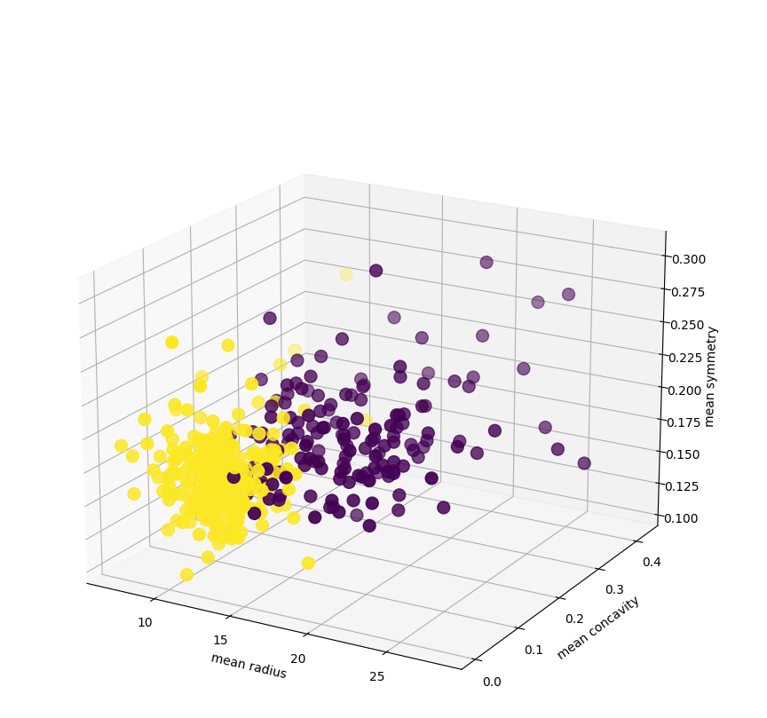
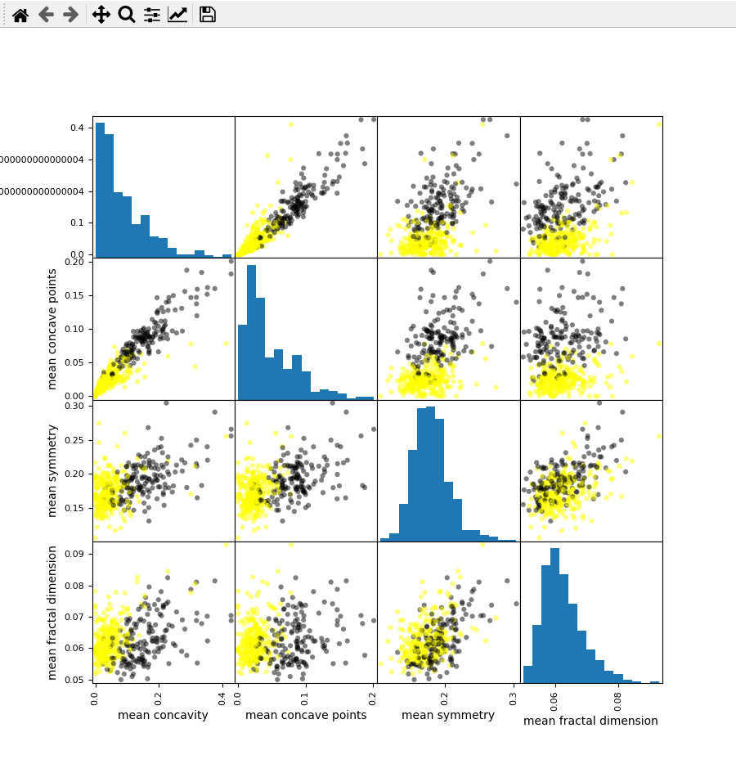
More Relevant Graphs

Slide 5
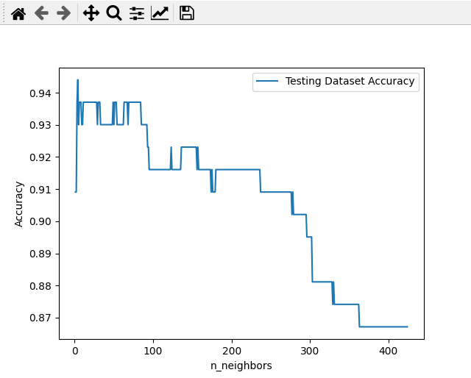
Statistical Summary Part 2
425 Nearest Neighbor Study
After about 200 NN, accuracy rate fell dramatically
Our Lowest Accuracy at 425 NN was 86.7%
Our Highest Accuracy stayed unchanged
Conclusion: Bigger is not always better.

Slide 6
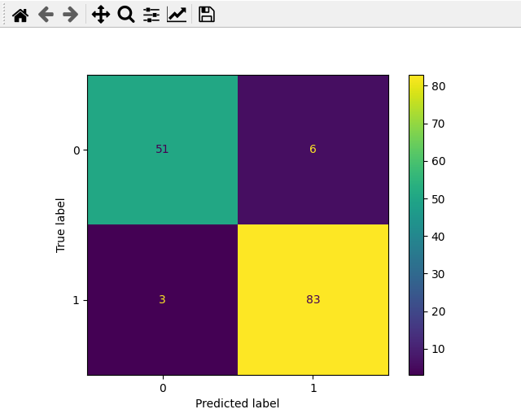
Statistical Summary Part 3 Confusion Matrix

Slide 7
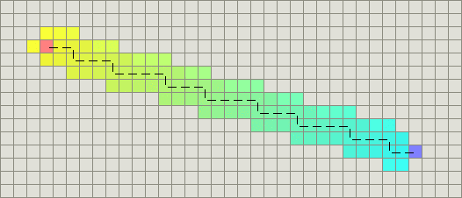

Distance Metric
Manhattan Distance Formula
Goes only in x or y or z direction
Can not go diagonally
Every step in a direction counts as 1
Total distance is the total number of steps taken to get to a point.
Used weights on distance instead of uniformity
More Accurate for a Feature Set of our size (30)
Using Euclidean Distance produced worse accuracies (up to a 25% loss in accuracy)

Slide 8

Best K, Worst K
5 Nearest Neighbors – Accuracy: 94.4
K > 350 Nearest Neighbors – Accuracy: 86.7

Slide 9
The Good, The Bad, and The Average
Good K
5 NN
Not always the best. Due to randomness of the data set, it might be a fluke
Accuracy: 94.4%
Average K
15 – 28 NN
Most Consistent high accuracy during testing.
Accuracy Average: 93.7%
Bad K
350 – 425 NN
Most Consistent worst accuracy during testing
Accuracy Average: 86.7%

Slide 10
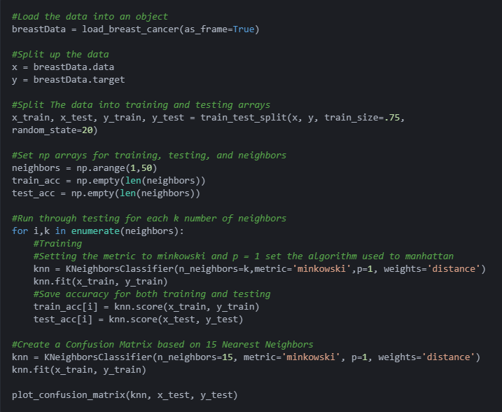
The Code

Slide 11
Conclusion
KNN is it good?
Yes in this case.
It had an accuracy of around 93% which is fairly high.
Is it always this good?
No.
Different datasets that we tested showed large variations in accuracy. Most notably Digit recognition had a max accuracy of 32%
What helped?
Using Manhattan Distance vs Euclidean Distance
Adding a weight based on distance instead of uniformity
A good dataset

